Slide 1
SWEN90016 Software Processes & Project Management
Risk Management
2019 – Semester 1
Tutorial 7
Copyright University of Melbourne 2017

Slide 2

Today’s aim
Understand Risk Management
for Language Research project

Slide 3
That’s interesting!
IBM (2008): 40% of IT projects meet schedule, budget, & quality goals
KPMG (2013): a third of the IT spend for an organization delivers the desired results
XDNET (2009): estimate that the cost of failed IT projects are as high as $6 Trillion worldwide
http://www-935.ibm.com/services/us/gbs/bus/
pdf/gbe03100-usen-03-making-change-work.pdf
https://www.kpmg.com/NZ/en/IssuesAndInsights/ArticlesPublications/Documents/KPMG-Project-Management-Survey-2013.pdf
http://www.zdnet.com/blog/projectfailures/
worldwide-cost-of-it-failure-6-2-trillion/7627

Slide 4
Have you been paying attention?
Risk Quiz
Answer the following six questions

Slide 5
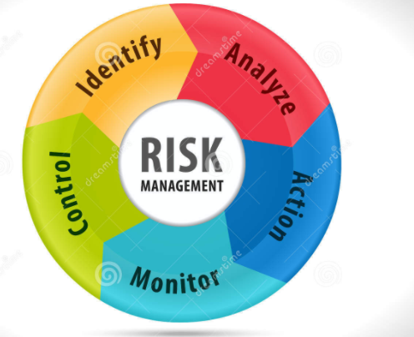
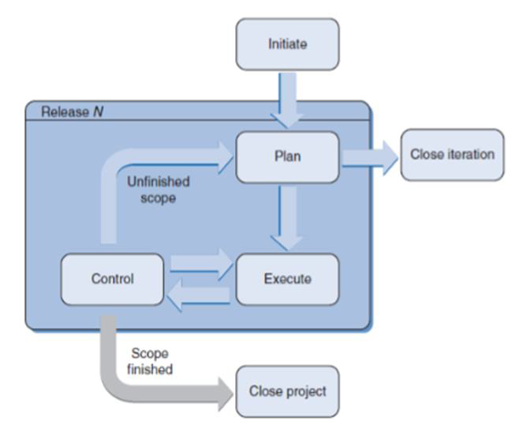
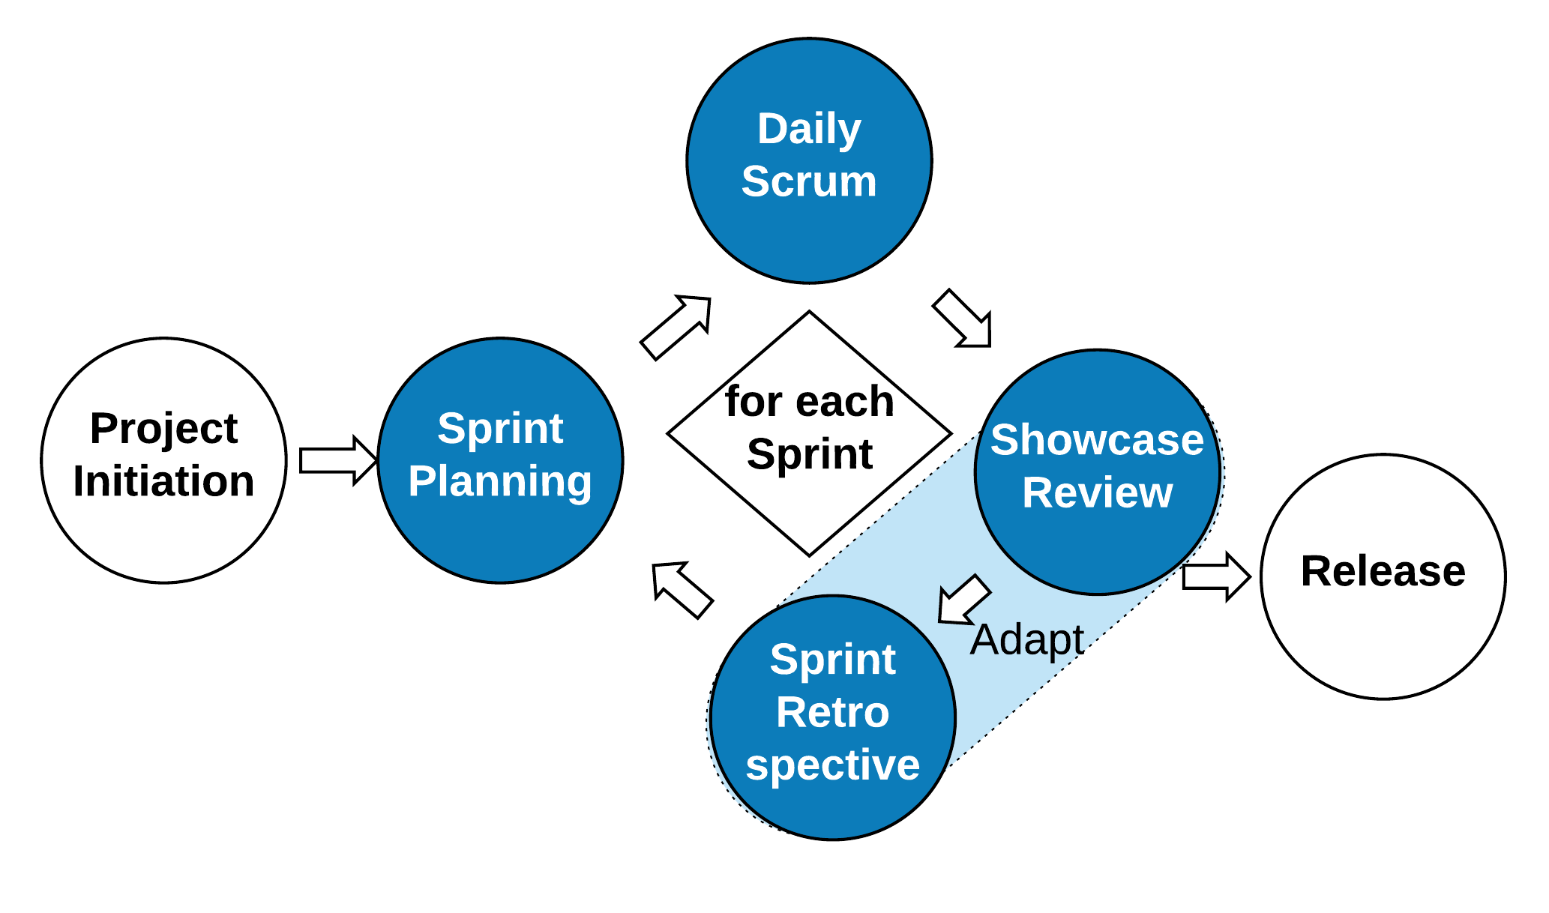
Getting Started
Define Project Risk
The effect (positive or negative) of uncertainty on project objectives.
1.
PMBOK
In what PM phase does
Risk Management start?
At the Initiation phase, (phase 1)
2.
Risk Management
From Lecture 8, slide 13
http://blog.zilicus.com/software-project-management-activities-roles/
… happens in all PM phases

Slide 6
Risk Activities Overview
From Lecture 8, slide 21
Identify
For example: brainstorm specific risks
slide 32
Analyze
- Evaluate
probability, impact & priority
- Document in table
slide 42
Respond
Choose strategy for threats & opportunities
slide 49
Monitor & Control
Set triggers, audit & review risk status

Slide 7
Risk Activities Flow
3-a: evaluate
probability, impact & priority
5. Act & measure
3-b:
Document
4. Decide Strategy
.

Slide 8
Risk Management example
For the Language Research Case Study
Some key characteristics are:
data integration from several distributed resources in several different formats. One feature of the system is to resolve the differences between idiosyncratic data formats.
sharing modules in a distributed environment, choose between a local installation which will generate multiple copies, or a central installation with remote access
- peer-to-peer control strategy

Slide 9
Identify: Brainstorm
Brainstorm all risks for the project.
Nominate new ideas
No filter!
Notes:
Risk management requires support and communication between stakeholders

Slide 10
Analyze
Evaluate probability, impact & priority
Sift through all the risks in the project
Review and debate their importance
3.
What are the top three/four risks to be controlled?
Document in a table.

Slide 11
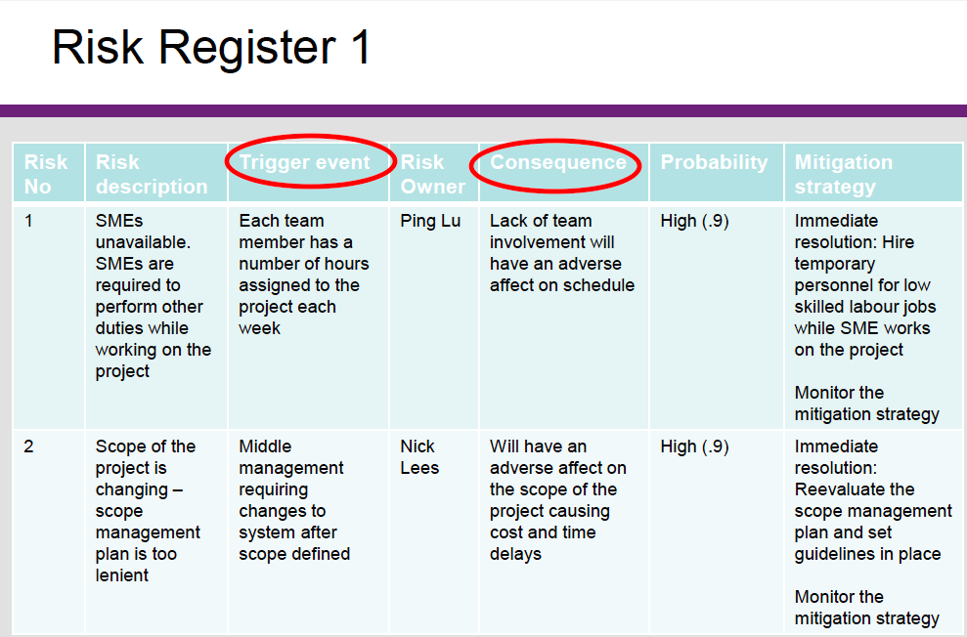
Risk Register: triggers & consequences

Slide 12
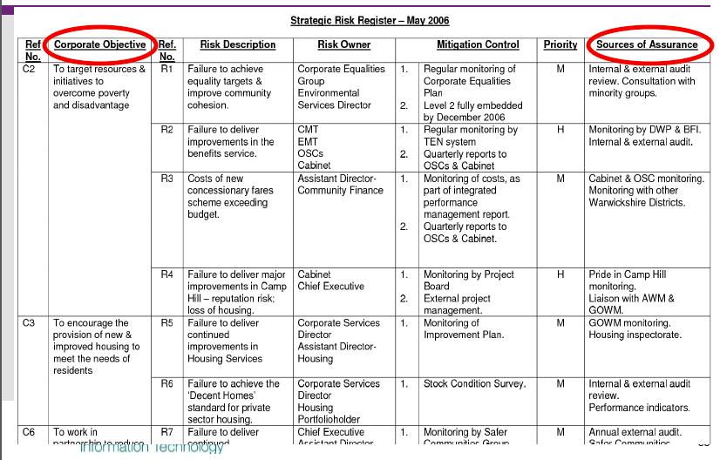
Risk Register: objective, owner, benchmark

Slide 13
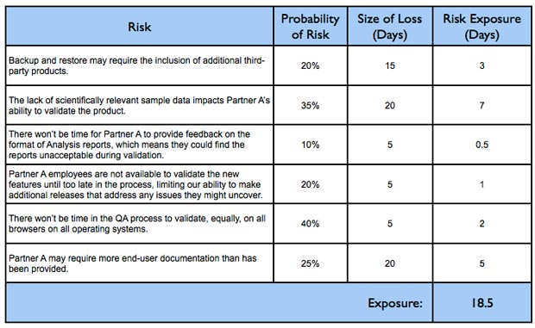
Risk Register: probability & time
Ref: https://www.mountaingoatsoftware.com/blog/managing-risk-on-agile-projects-with-the-risk-burndown-chart

Slide 14
Analyze: Risk Register
4.
Create a risk register to document the controlled risks for your project
Id | Risk Description
Risk 1
Risk 2`
Risk 3

Slide 15
Analyze: Risk Register
4.
Create a risk register to document the controlled risks for your project
Id | Risk Description
Risk 1 | The inexperience of the software developers slows down the rate of development and the delay contributes to the project failure
Risk 2 | The customer’s Shipping Booking request does not include a priority value, so manual intervention will reduce the system’s effectiveness.
Risk 3 | No facility to charge a reservation fee when making a Shipping Booking request. Multiple and fictitious requests would make the website vulnerable to DoS cyber attacks.
Project risk: staff skill level
Product risk: design problem
Business risk: service disruption

Slide 16
Analyze
5.
Calculate: :probability impact exposure
Risk | Probability of Risk | Size of Loss (Days) | Risk Exposure (Days)
Risk 1
Risk 2`
Risk 3
the impact to the schedule if the risk did occur
Risk probability = a measure between 0 and 1 inclusive
Risk impact = finite grade of 1-5 scale, such as:
(1) none; (2) minimal; (3) moderate; (4) severe; (5) catastrophic impact;
monetary cost or time cost?
Risk exposure = probability × impact

Slide 17
Analyze
5.
Calculate::probability impact exposure
Risk | Probability of Risk | Size of Loss (Days) Out of 30 days total For 6 week project | Risk Exposure (Days)
Risk 1 –Flat priority causes ineffective automation | 10% | 5 days Moderate - 3 | 0.5 days
Risk 2` Data security | 5% | 15 days Severe - 4 | 0.75 days
Risk 3 – dev team delay | 25% | 2 days Minimal - 2 | 0.5 days

Slide 18
Respond, Monitor & Control
Add Response strategy for handling threats & opportunities
Accept or Ignore
Avoid
Mitigate
Transfer
Exploit
Enhance
Share
Accept
Monitor Process
Audit
Review
Status meetings
Lecture 8: slide 50

Slide 19
Agile SDLC Risk Management
Identify – capture risks in Risk Register
Analyze – Product Backlog groomed and priority given to all User Stories, including those which capture risk
leadinganswers.typepad.com/leading_answers/2007/09/agile-risk-mana.html
Respond – mitigate Risk in Sprint
Monitor – during Sprint Review & Retrospective, Sprint Planning

Slide 20
Agile Risk Process
What
Where
Who
When
Why
Sprint Review risk evaluation
Build small piece of working software with minimal features
Showcase the product chunk to the stakeholders early
Fail fast and as cheaply as possible, & get timely feedback
Capture the risk item in the Product Backlog
The Product Owner sets the priority of the risk item
Refer to: Tutorial 5_procurment:Change Control, slide 20

Slide 21
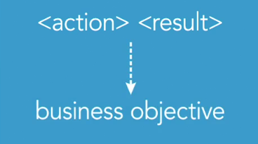
Agile Risk Process
Sprint Review risk evaluation
The format of a risk item in the Product Backlog can vary
Optionally use Feature-Driven Development (FDD) syntax,
(when the role is not obvious)
Example.
Risk 1: include request priority, for an effective booking service
www.mountaingoatsoftware.com/blog/not-everything-needs-to-be-a-user-story-using-fdd-features

Slide 22
Control
6 a.
What are the key differences in characteristics between the
Formal-incremental and Agile-iterative SDLC?
Formal
Explicit architecture
Explicit UX design
(end user consideration)
Explicit configuration
Agile
Productivity increase
Responsive to feedback
(client satisfaction)
Working software
b.
How would these characteristics influence risk management?
Plan ahead Plan Just-In-Time

Slide 23
Thank You!

